Slide 1
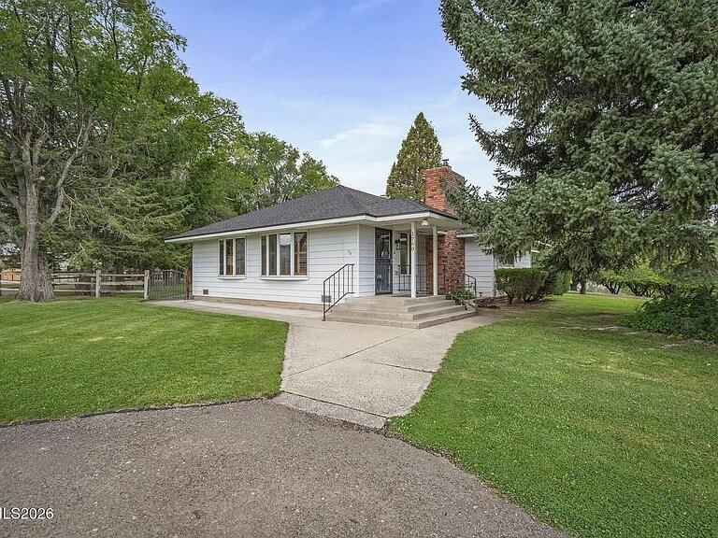
The Garson Farmhouse
A restoration proposal for a 1950s ranch house in Verdi, Nevada
HERITAGE RANCH REVIVAL · INTERIOR, EXTERIOR AND ESTATE

Slide 2
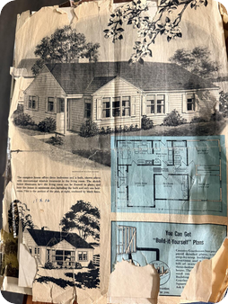
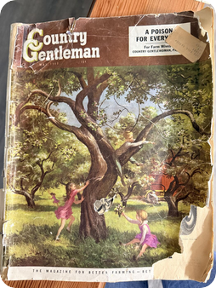
A house ordered from a magazine
The Garson family ran a large longhorn cattle operation in Verdi, Nevada.
They built the house from a "Build-it-Yourself" plan published in Country Gentleman.
Two acres are all that remain of the ranch.
The restoration keeps what the family built and tells why each choice was made.
The 1950s plan clipping
Country Gentleman, kept by the family
Notes:
Open with the story. The clipping and the magazine both survived with the house. Everything that follows is built to honor them.

Slide 3
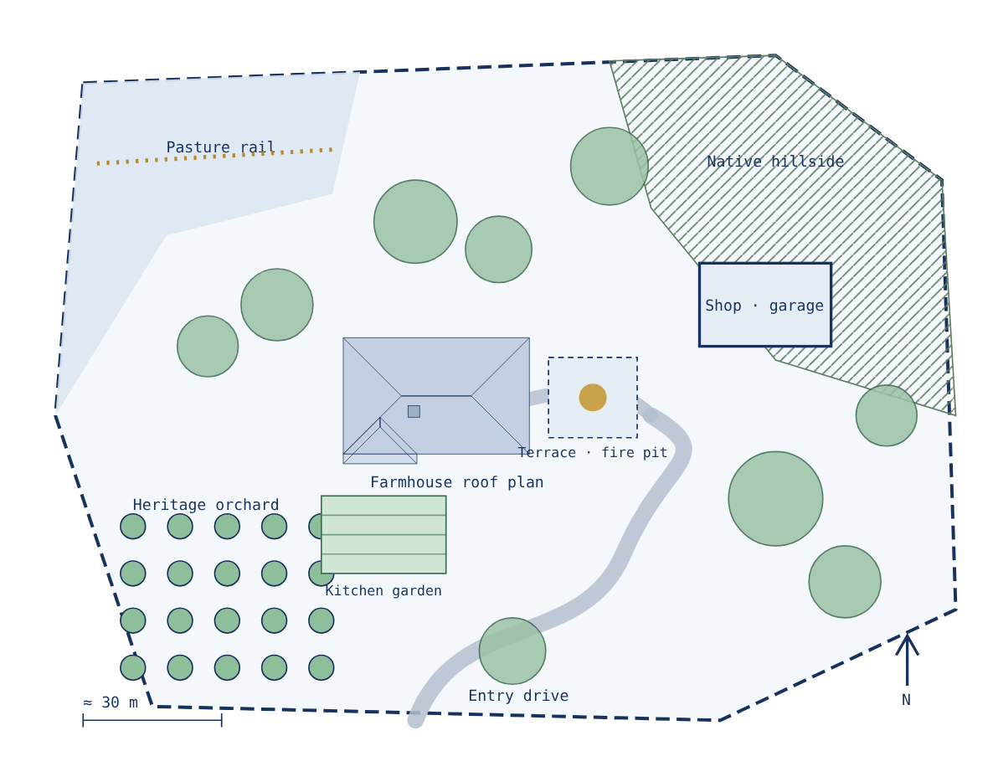
Two acres, planned as a working landscape
Winding gravel drive kept from the original lot
Heritage orchard, after the tree on the magazine cover
Rail fence and pasture edge, a nod to the longhorn ranch
Terrace and fire pit off the dining room
Kitchen garden by the back door
Native hillside planting; mature trees stay
Schematic. Boundaries and tree positions are indicative until surveyed.

Slide 4
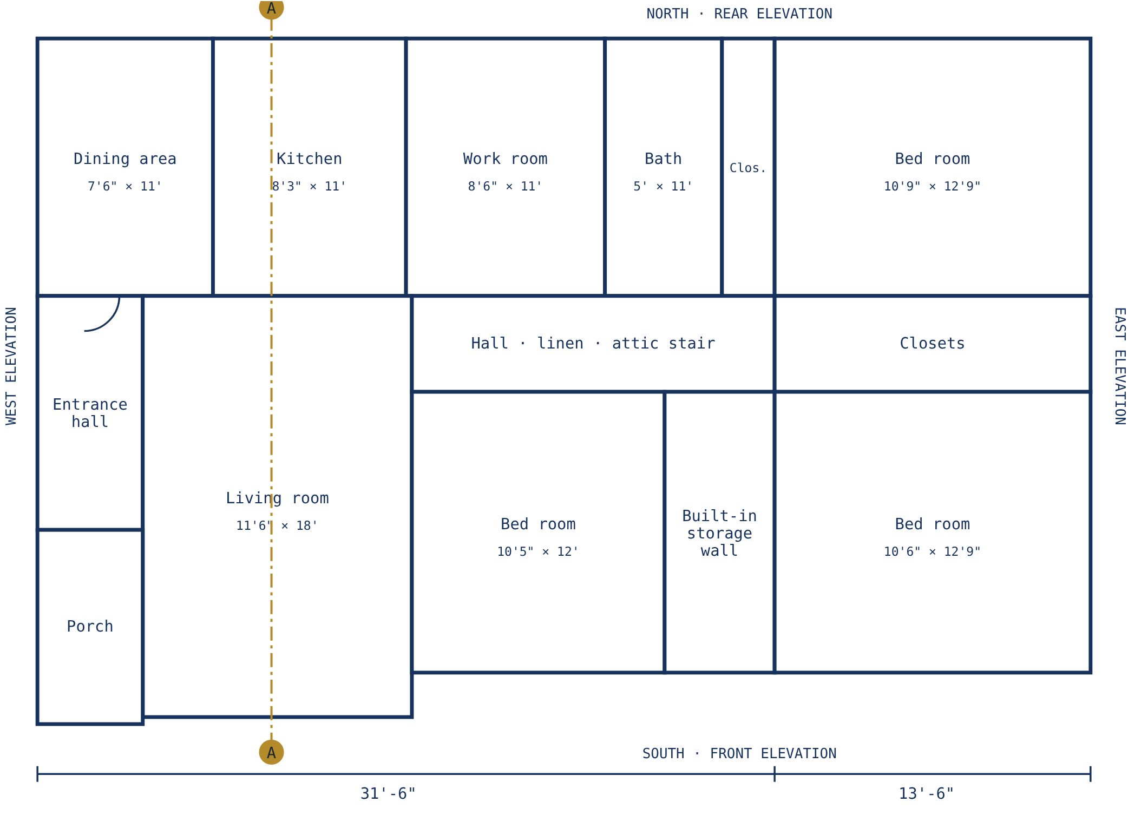
The plan as built in the 1950s
45 ft by 29 ft footprint
Three bedrooms, one bath, a work room off the kitchen
Living room 11'6" × 18', with an entrance hall and porch
Floor furnace and attic stair noted on the drawing
Redrawn from the published plan. Dimensions as printed, not field measured.

Slide 5
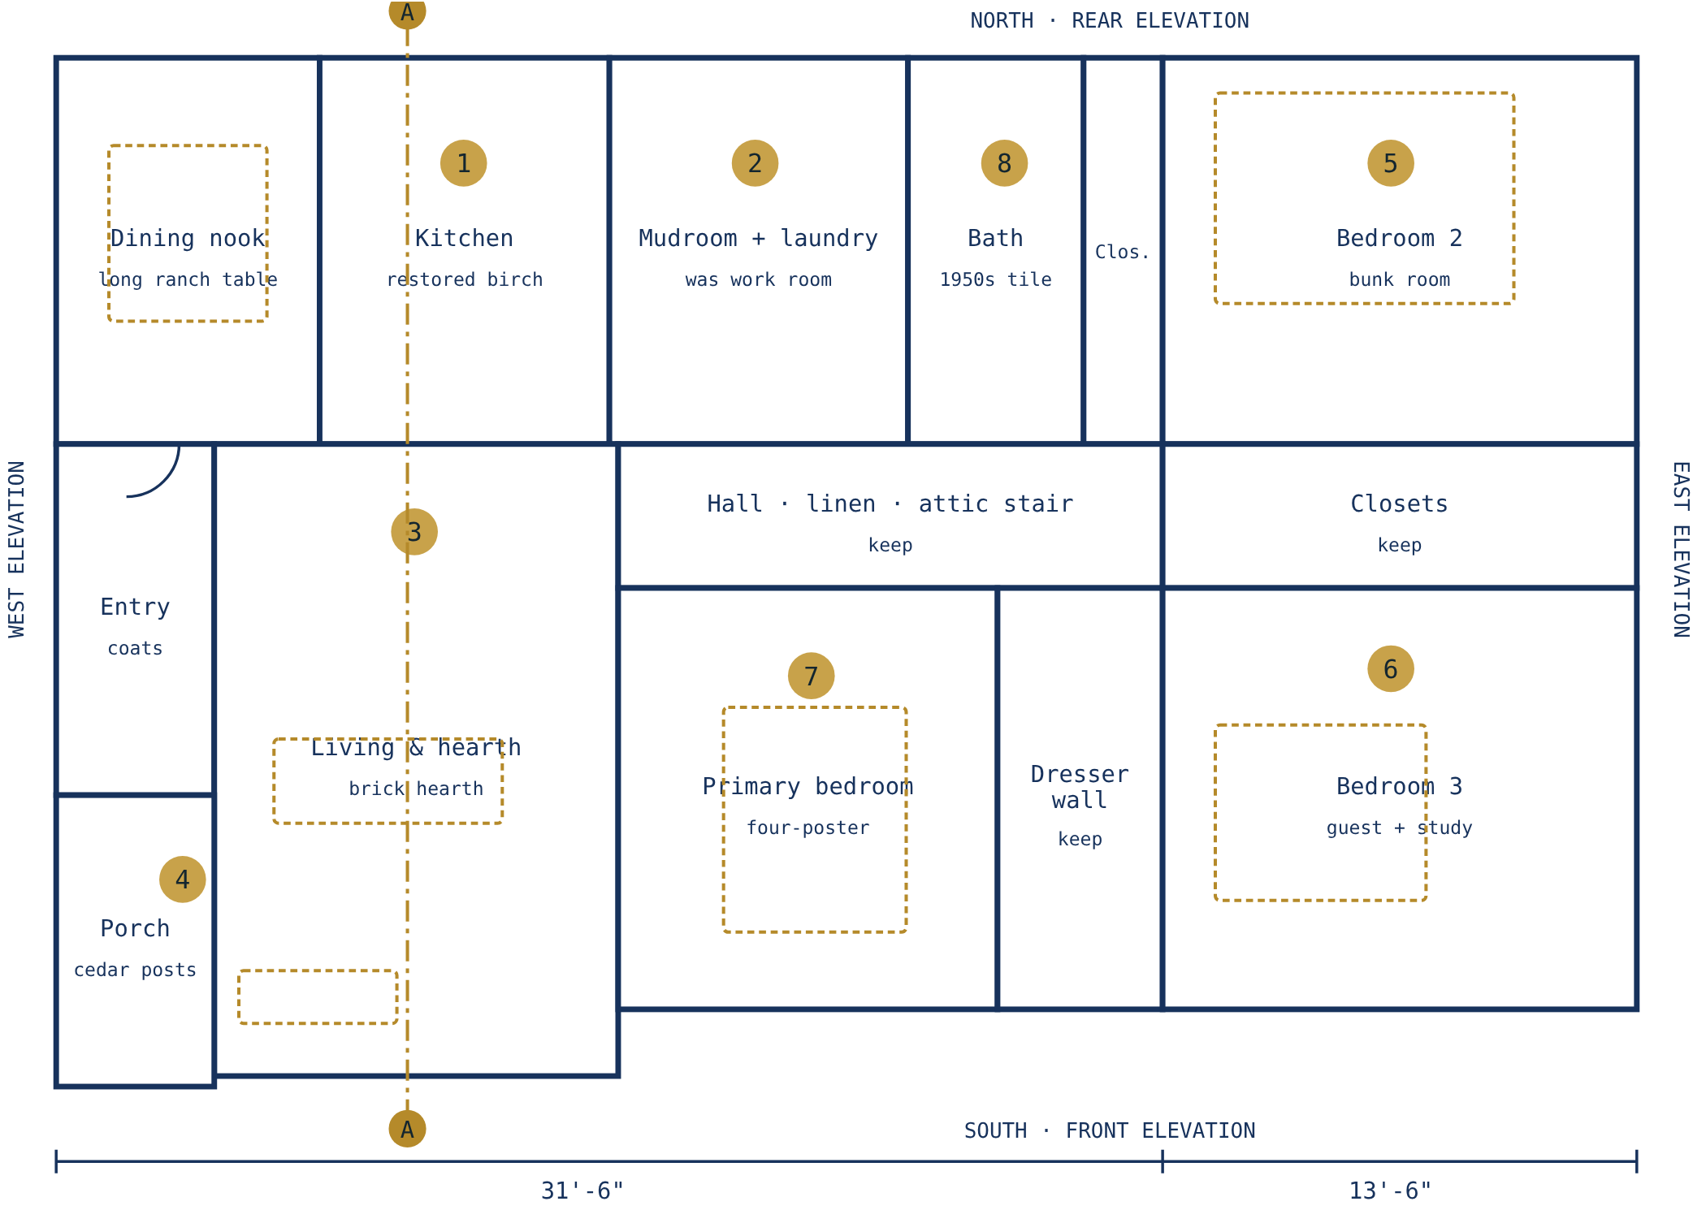
The restoration plan
1 Restore the birch kitchen, add soapstone and sage tile
2 Mudroom with boot bench, hooks and laundry
3 Hearth wall: barn-beam mantel, hidden TV
4 Wider porch with cedar posts and a Truckee-blue door
5 Built-in bunk wall for the grandchildren
6 Guest room and study around the built-in
7 Primary bedroom with refinished floor and drapery
8 Period bath: white tile and black hex floor

Slide 6
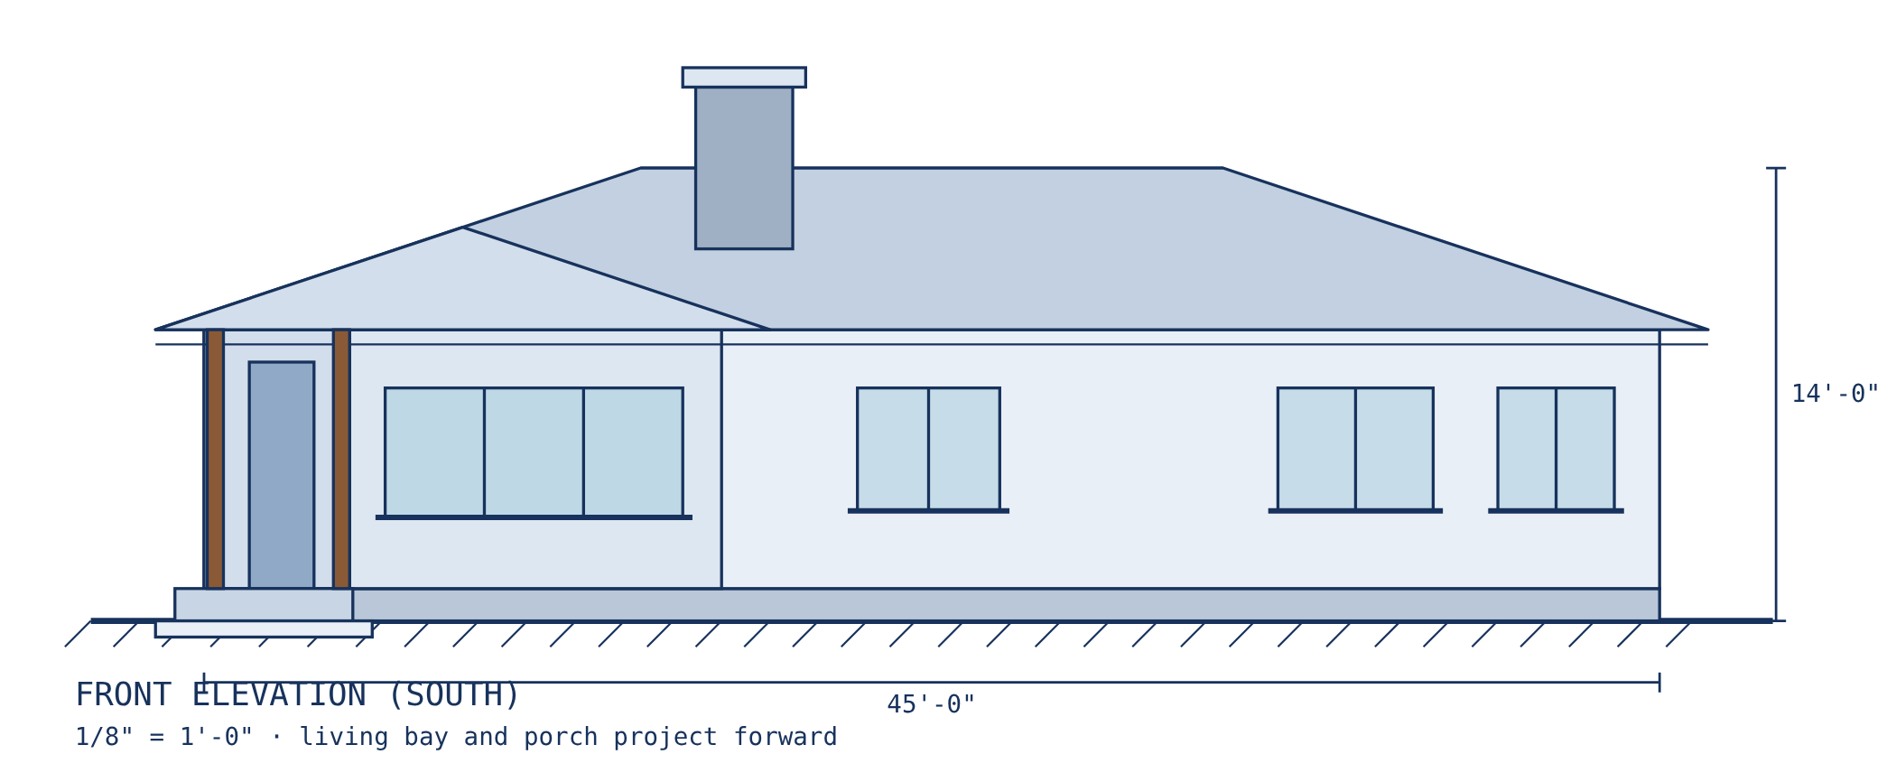
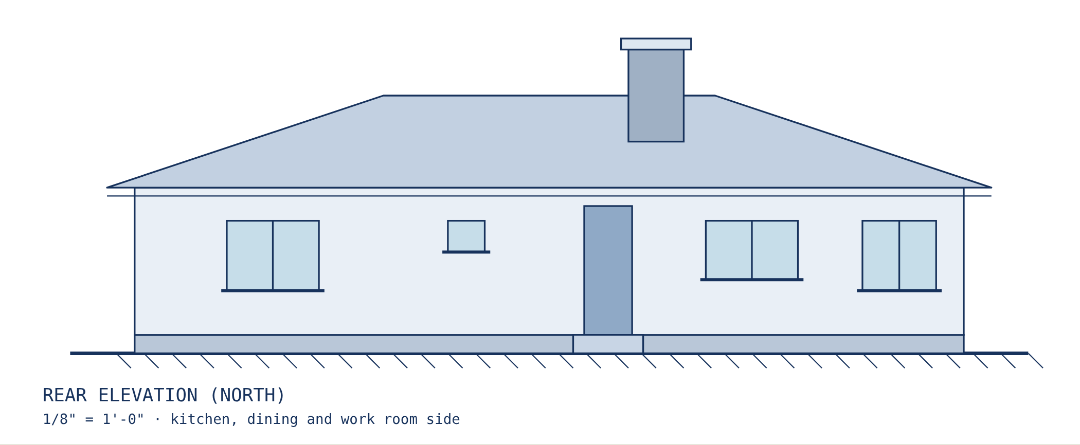
Front and rear elevations
45 ft wide, 14 ft to ridge
4:12 hip roof with a projecting front wing
Living bay and porch face south
Plate height and pitch are assumed; confirm on site

Slide 7
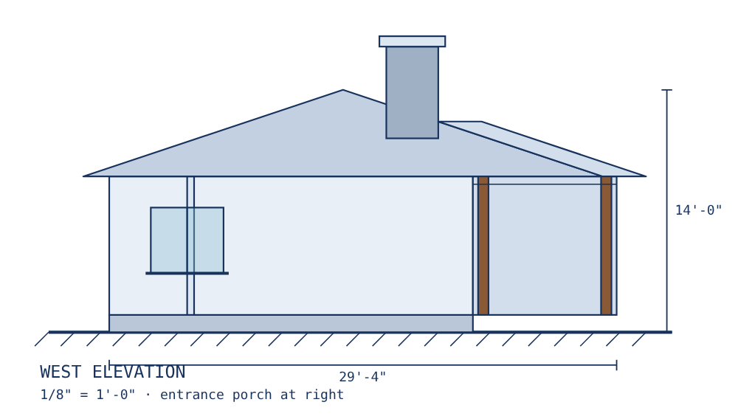
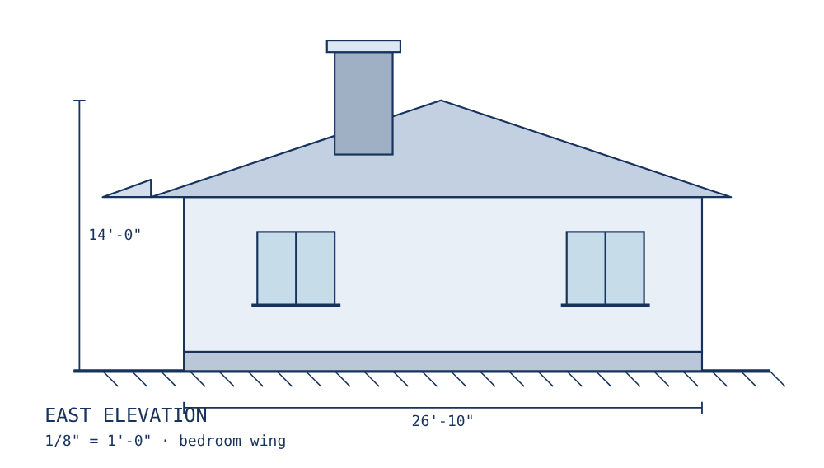
Side elevations
West side shows the entrance porch and hip end of the front wing. East side is the bedroom wing, with the chimney rising above the roof.

Slide 8
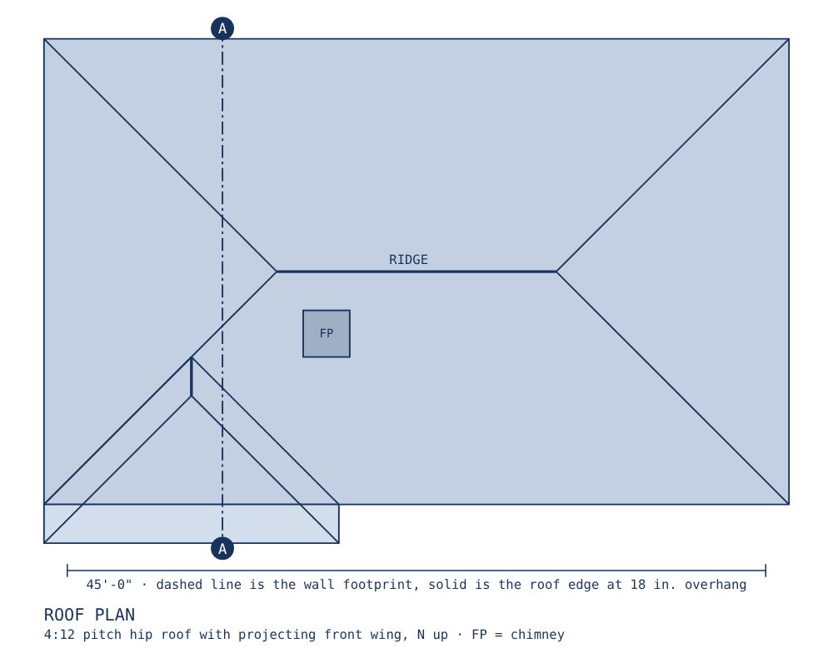
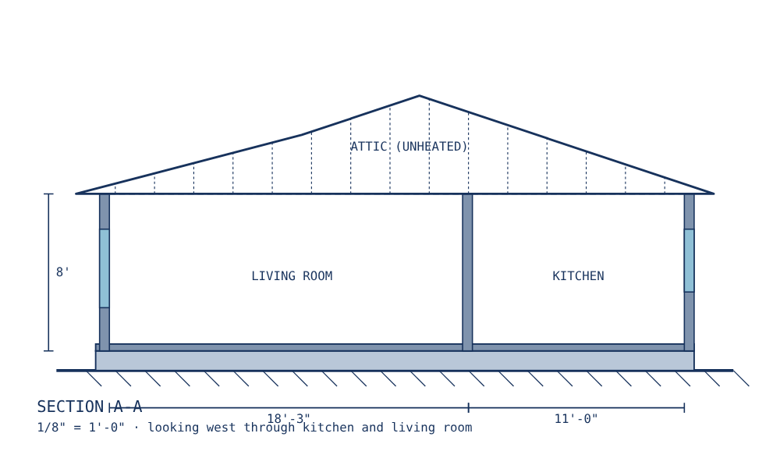
Roof plan and building section

Slide 9
Heritage ranch revival
Truckee Blue
Saddle
Birch
Sage
Bone
Iron
#4A7185
#6E4527
#C98D45
#8A9A76
#E5DFCF
#2B2A27
The colours already in the house, plus the ranch around it. The blue walls stay. The birch cabinetry is the heart of the kitchen. Saddle brown and sage come from leather and sagebrush. Materials are honest: oak, soapstone, brass, slate, linen.

Slide 10
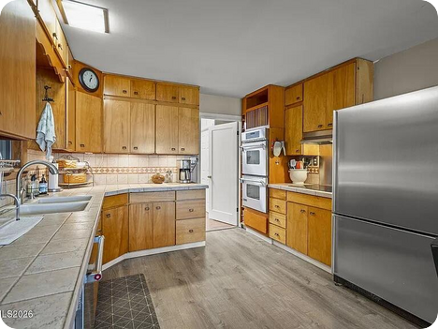
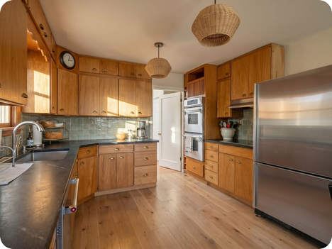
Kitchen
BEFORE
AFTER · RENDER
Keep Original birch cabinets, refinished in matte oil · Window over the sink · Stainless appliances for now
Change Honed soapstone counters in place of tile · Handmade sage-glazed tile backsplash · Aged brass cup pulls, schoolhouse pendants · Wide-plank white oak floor
Notes:
Today: Original birch cabinets with scalloped valance, tile counters, dated tile backsplash, laminate plank floor. Design intent: The cabinets are the soul of the room and they stay. Refinish them, add warmth and honest materials, and light the room like a farm kitchen.

Slide 11
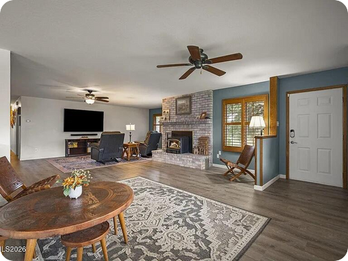
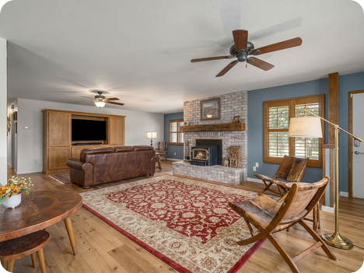
Living & hearth
BEFORE
AFTER · RENDER
Keep Brick fireplace and plantation shutters · Blue-grey accent wall · Open flow to dining
Change Reclaimed barn-beam mantel · TV concealed behind a sliding cabinet panel · Leather sofa and two folding hide chairs · Large wool rug, floor lamp for reading
Notes:
Today: Painted brick fireplace with insert, blue-grey accent wall, plantation shutters, grey laminate floor and a wall-mounted TV. Design intent: Make the hearth the centre of the room. Keep the shutters and the blue wall, and let leather, wool and wood do the rest.

Slide 12
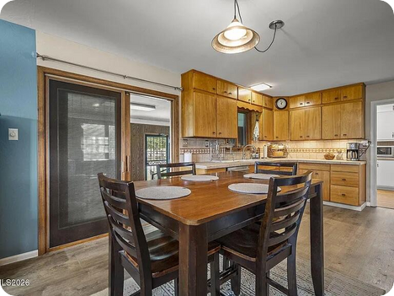
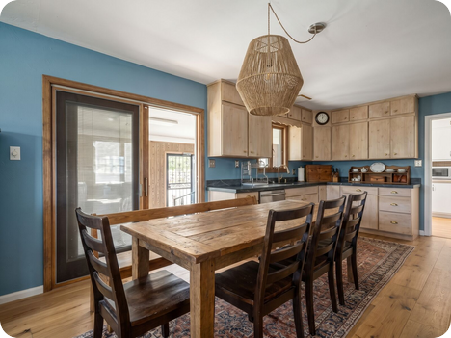
Dining
BEFORE
AFTER · RENDER
Keep Sliding door to the yard · Blue wall
Change Long ranch table with a bench on one side · Woven cord pendant over the table · Sideboard for the family china · Wool runner rug
Notes:
Today: Dark dining set on a patterned rug under a single pendant, blue wall behind, sliding glass door to the yard. Design intent: A table long enough for family and friends. Warm, low light and a view out to the yard.

Slide 13
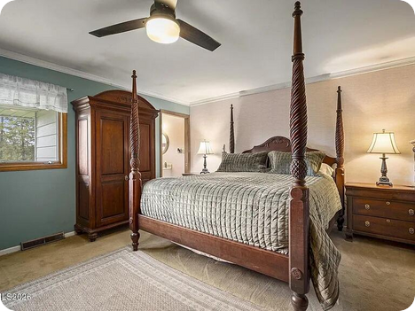
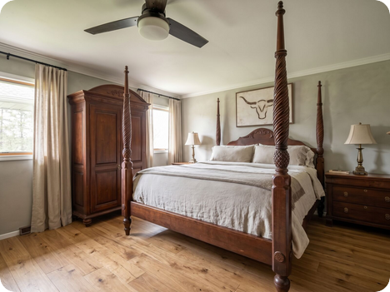
Primary bedroom
BEFORE
AFTER · RENDER
Keep Four-poster bed and armoire · Window with garden view
Change Warm plaster-look wall finish, picture rail · Refinished hardwood in place of carpet · Linen drapes on a black iron rod · Cattle-brand art over the bed
Notes:
Today: Four-poster bed, blue wall, pale carpet and a ceiling fan. Design intent: A calm room for the next chapter: soft wall colour, deep linen drapery and the family furniture treated as heirlooms.

Slide 14
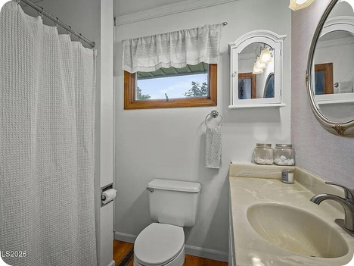
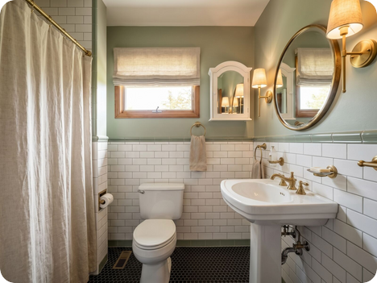
Bathroom
BEFORE
AFTER · RENDER
Keep Wood window · Footprint, tub position
Change White subway tile to 54 inches, sage cap trim · Black hexagon mosaic floor · Pedestal sink, framed mirror, brass sconce · Linen shower curtain on a brass rod
Notes:
Today: Cultured-marble vanity top, plain tub curtain, oval mirror, small wood window. Design intent: A period bathroom: white tile, black hex floor and a single piece of brass.

Slide 15
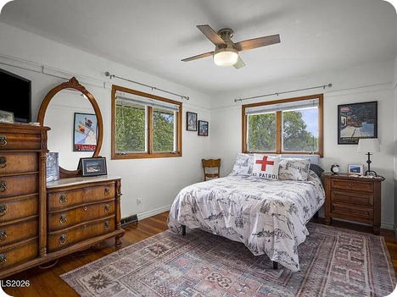
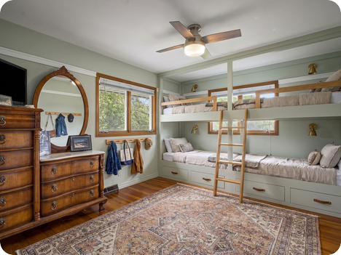
Bedroom 2
BEFORE
AFTER · RENDER
Keep Hardwood floor · Wood-trimmed windows
Change Built-in bunk wall with ladder and reading lights · Soft sage walls, white picture rail · Patterned wool rug · Wall pegs for coats and bags
Notes:
Today: Red-cross bedspread, rich hardwood floor, wood-trimmed windows and a tall dresser. Design intent: The grandchildren's room. Keep the beautiful floor and windows and add a built-in bunk that sleeps four.

Slide 16
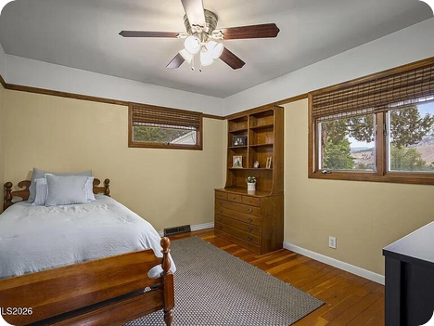
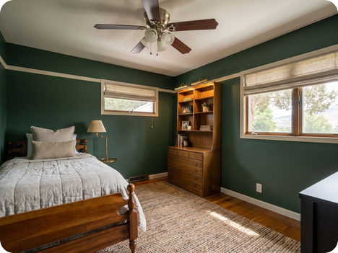
Bedroom 3
BEFORE
AFTER · RENDER
Keep Built-in bookcase and dresser · Wood bed frame · Hardwood floor
Change Deep green wall behind the built-in · Painted trim in bone white · Picture lights over the books · Linen roman shades
Notes:
Today: Mustard-yellow walls, built-in bookcase and drawers, bamboo shades, wood bed frame. Design intent: A guest room that doubles as a study. The built-in is the best thing in the room and gets the spotlight.

Slide 17
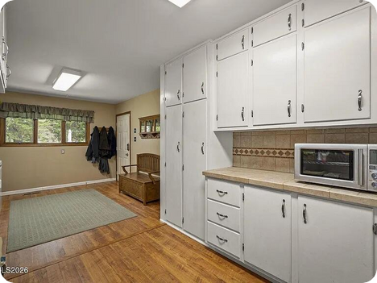
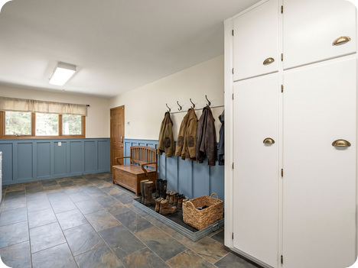
Mudroom
BEFORE
AFTER · RENDER
Keep Tall painted cabinets · Wood bench
Change Board-and-batten wainscot in Truckee blue · Iron hooks and a boot tray · Slate-look tile floor · Brass cabinet pulls
Notes:
Today: White painted cabinets, tile counter, wood bench, tan walls. Design intent: The back door is how the house is really used, so it should work hard: boots, coats, grandchildren and groceries.

Slide 18
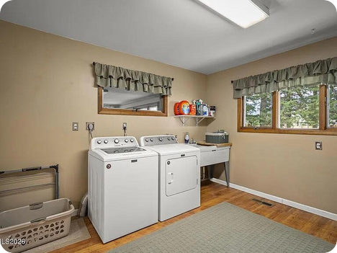
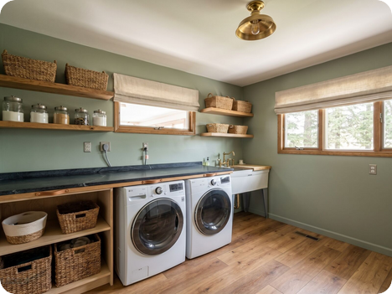
Laundry
BEFORE
AFTER · RENDER
Keep Utility sink · Window light
Change Sage painted walls and wood shelf · Open shelving with baskets · Wood-look vinyl floor, easy to clean · Folding counter over the machines
Notes:
Today: Tan walls, green valances, white washer and dryer, utility sink. Design intent: Keep the useful old utility sink and make the room look like it belongs to the rest of the house.

Slide 19
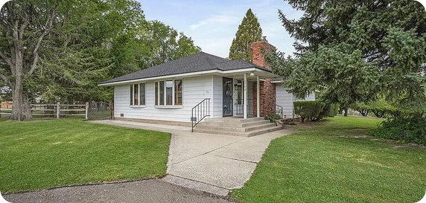
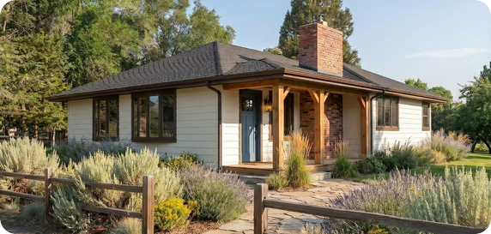
The front of the house
BEFORE
AFTER · RENDER
WALLS AND TRIM
PORCH AND ENTRY
LANDSCAPE
Bone white lap siding
Saddle brown trim
Truckee blue front door
Cedar posts, wider landing
Flagstone walk
Aged brass lantern
Split-rail front fence
Sagebrush and lavender beds
Keep mature trees

Slide 20
Finish schedule
Room | Surface | Specification | Why
Kitchen | Cabinets | Refinish original birch, matte hardwax oil | Keep the room's history
Kitchen | Counters | Honed soapstone, 30 mm | Replaces tile; ages well
Kitchen | Backsplash | Handmade tile, sage glaze | Links to garden palette
Living | Walls | Truckee blue accent wall retained; others warm bone | Existing colour reused
Living | Mantel | Reclaimed barn beam, oiled | Ranch material
Living / all | Floors | Wide-plank white oak or refinished original | Replaces laminate
Primary | Walls | Plaster-look finish, picture rail | Soft, calm
Bath | Tile | White subway to 54 in., black hex floor | 1950s period
Bedroom 2 | Built-in | Four-berth bunk wall in painted birch ply | Grandchildren
Bedroom 3 | Walls | Deep green behind built-in | Showcases the cabinetry
Full schedule, quantities and pricing follow after site measurement.

Slide 21
Next chapter, same house
Site measure and confirm the plan dimensions
Approve palette and material direction
Build the procurement list from the finish schedule
Price and phase the work: exterior, kitchen, then bedrooms

